Slide 1
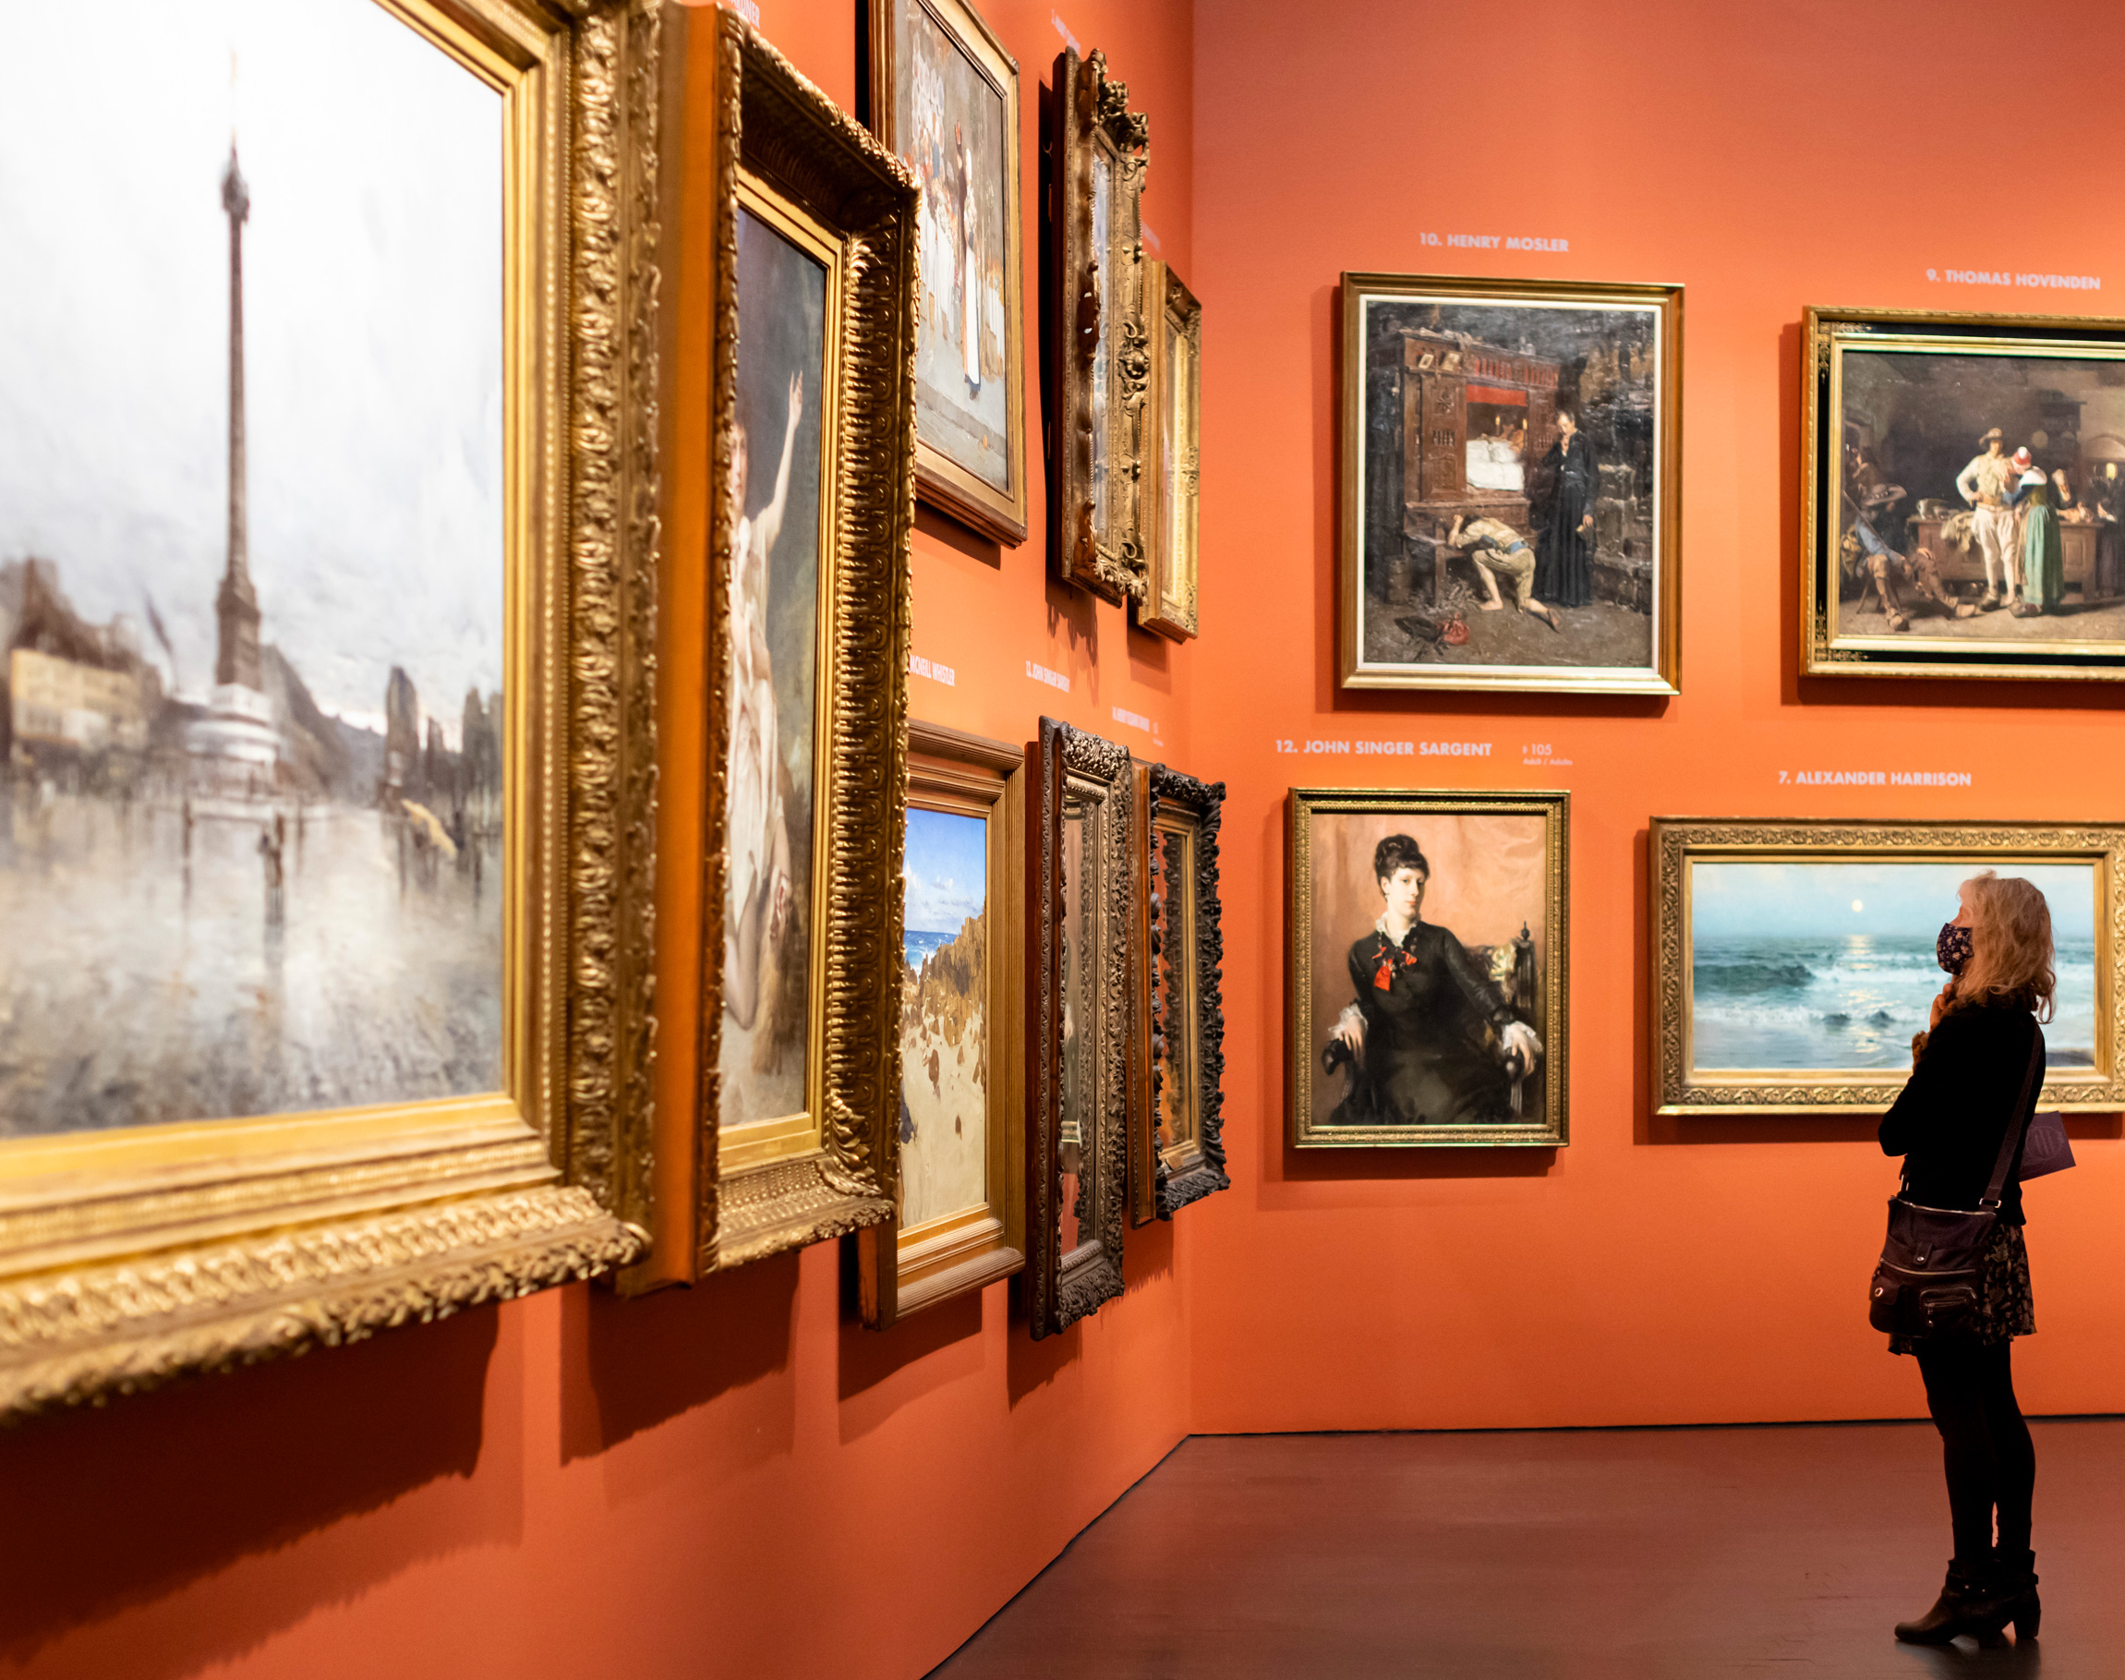
Collections Demographic Analysis
At the Trout Gallery

Slide 2
Research Question
Museum keep a body of artworks in their collections
Mostly obtained from donations
Circulate
Collections’ Function
Preservation, Education, Public Engagement, Innovation
within internal / external exhibitions
Research:
Collections Demographic Insights for Operation and Marketing Purposes

Slide 3
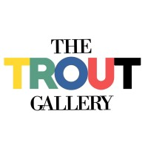
Data Retrieval
Discussion with the Director, Shannon Egan

Slide 4

About the Dataset
Creator
Artist name
Display Title
Artwork title
Media & Support
Medium and surface of the artwork
Split into Medium and Support features
Creation Date
Donor
Country
Year of the created date
Generalized format 18th century = 1700s
Name of the Donor
Origin of the artwork
Changed to Modern country names
8 columns
11630 records

Slide 5


Cleaning the Data
Creation Date
Change into standardized Year format
18th century = 1700s, 12th to 14th = 1100s – 1300s
Country
ISO code standardization (Global Map plotting)
Media & Support
Remove repetitive categorizations
Lithograph process = lithograph, color woodcut = woodcut
Donor
First name, Last name

Slide 6
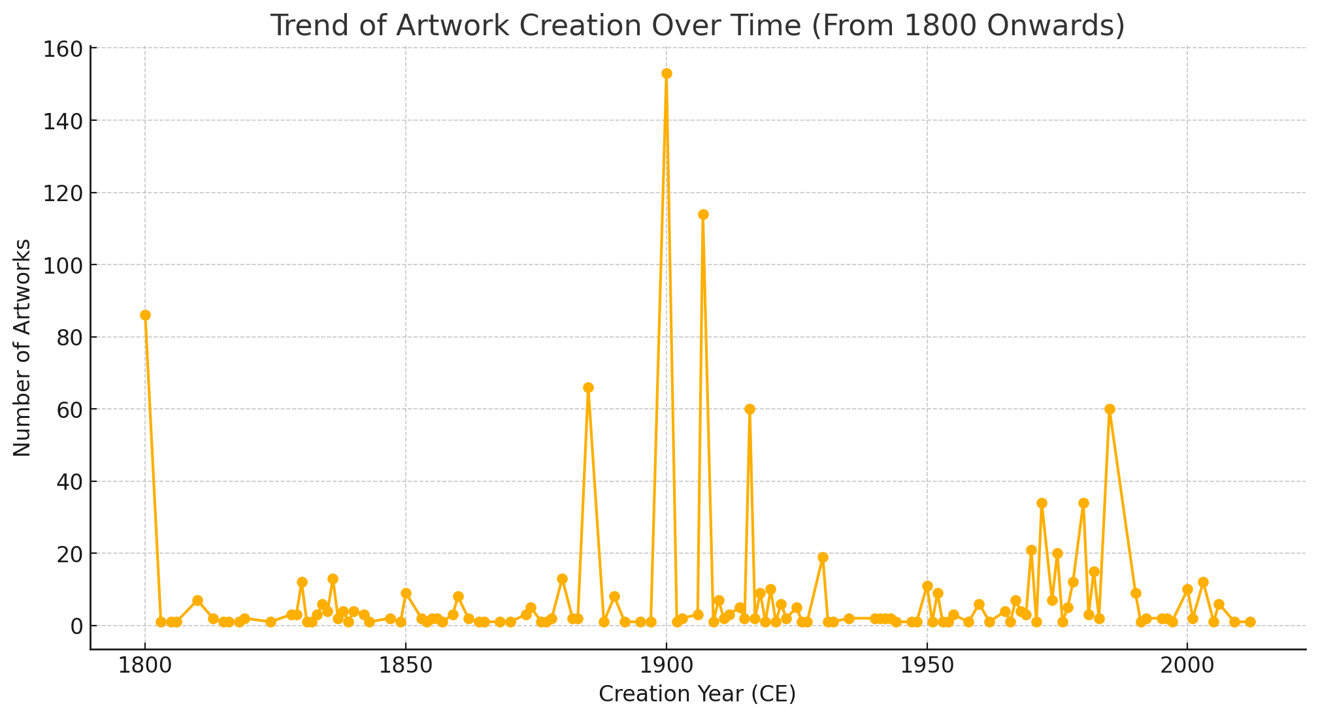
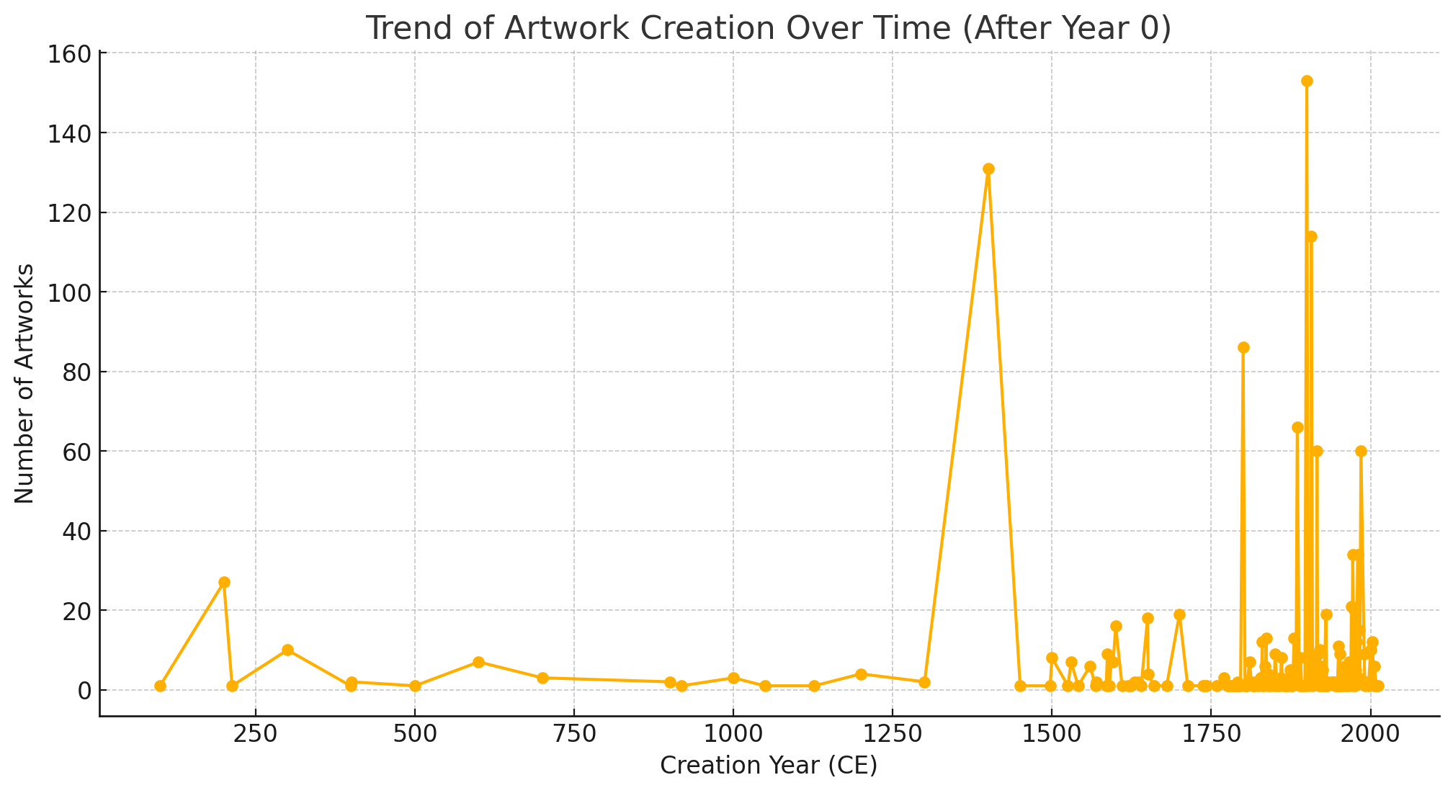
Creation Date Trend

Slide 7
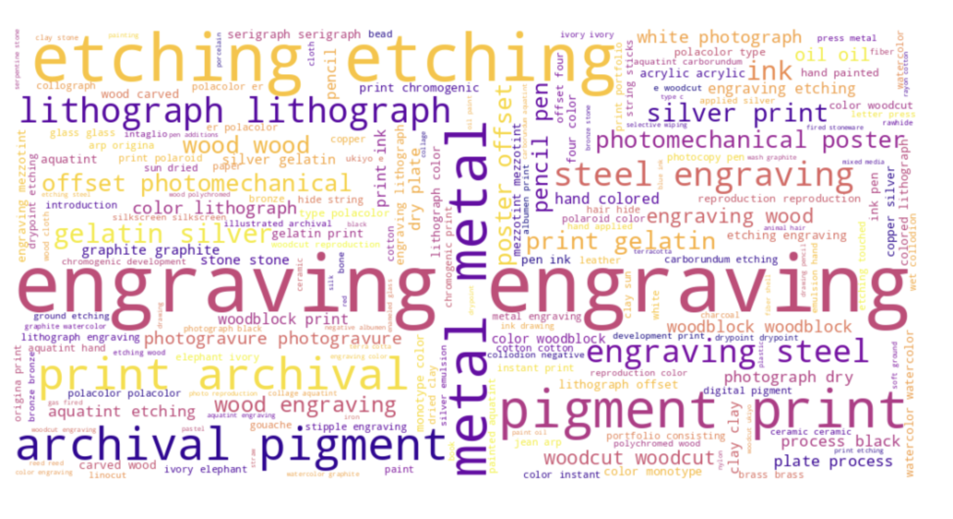
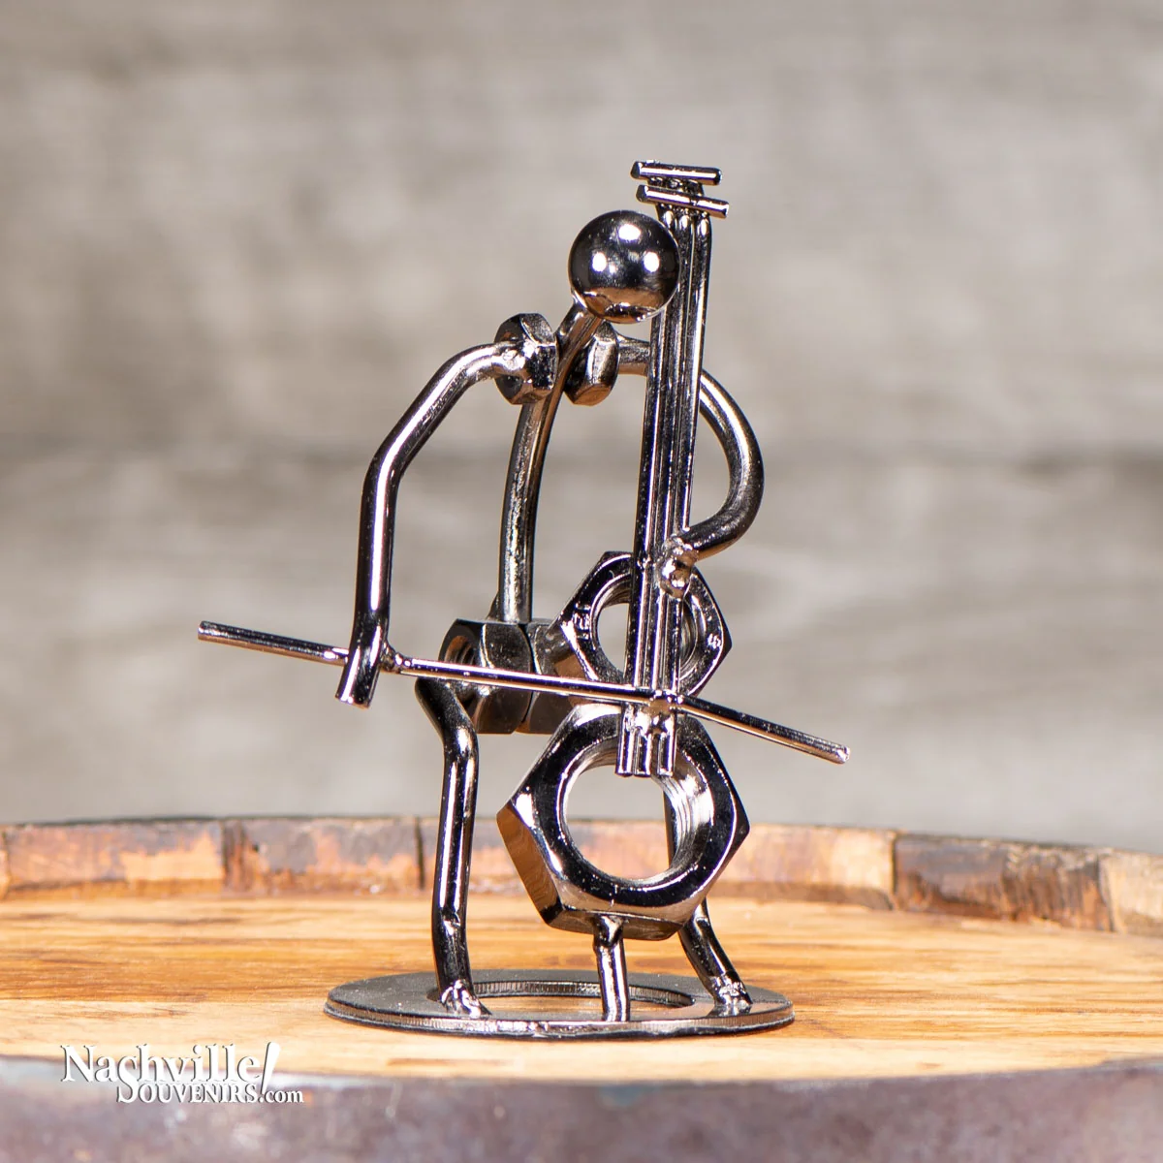
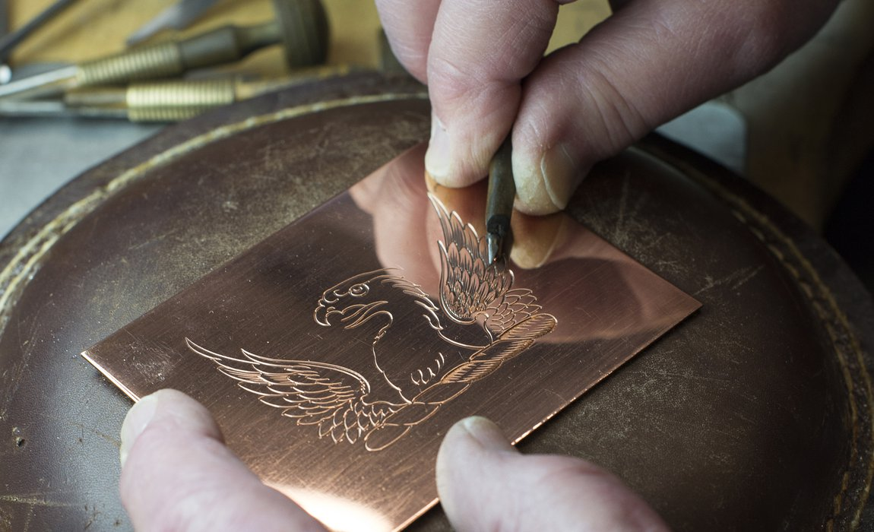
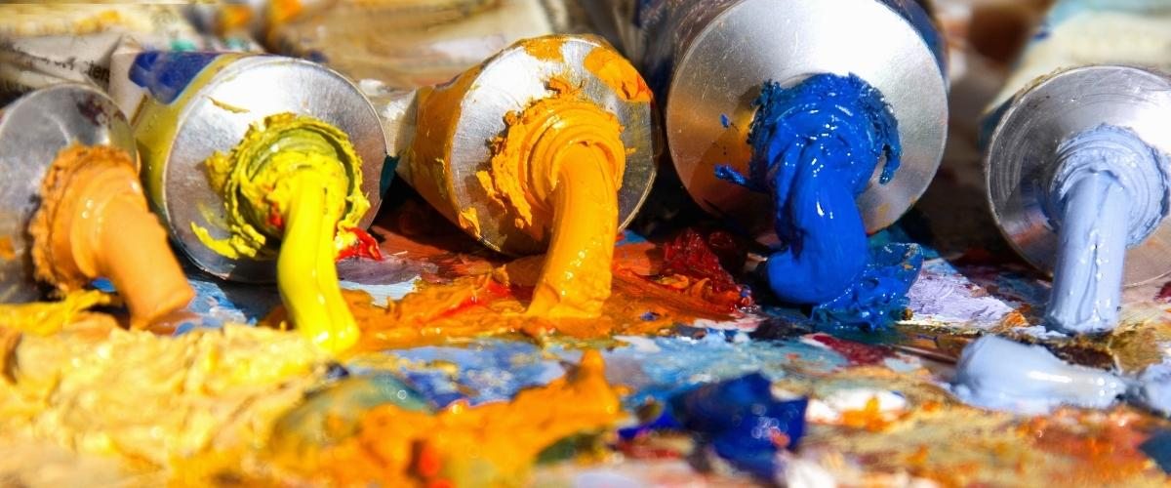
Medium Counts

Slide 8
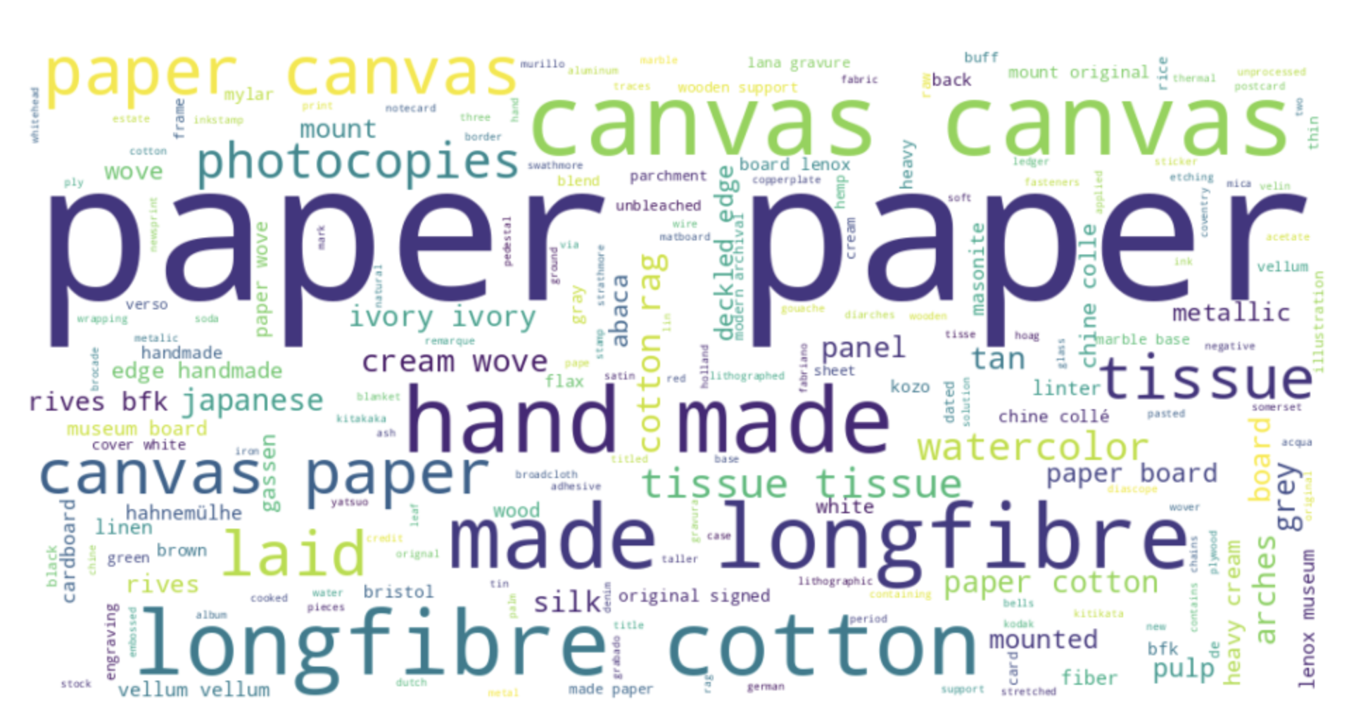

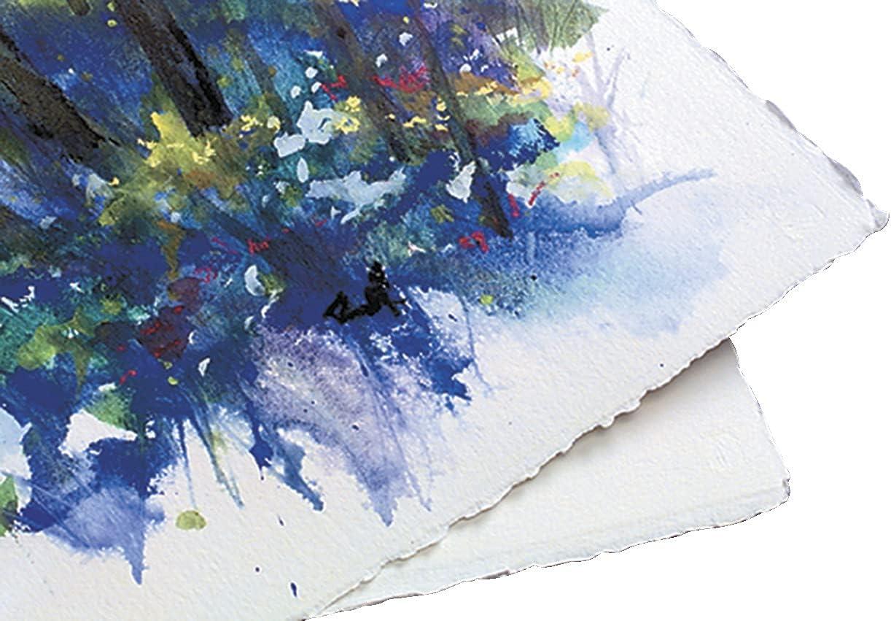
Support Counts

Slide 9
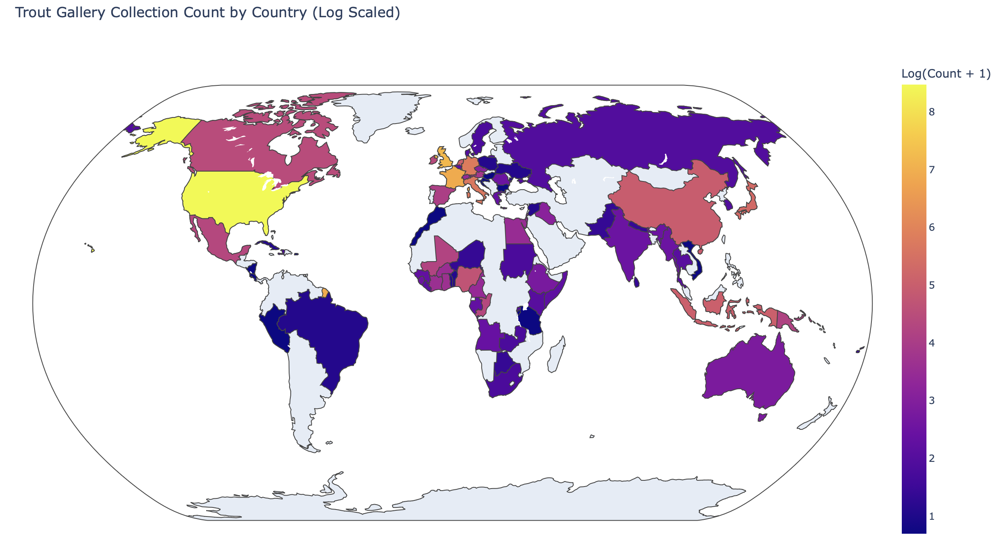
Visualization of Origin
Map Visualization Link

Slide 10


Implications on Stakeholders
Museum Leadership & Curators
Insights into collection diversity
Address gaps in representation
Funders & Donors
Insights of current collection focus
Shifting museum’s interest to attract more funds
Private donors may shift support based on trends

Slide 11
Ethical, Legal, Societal Implications
Bias in Data Interpretation
Criteria of collection diversity, artist demographics
Data Privacy & Protection
Donor Privacy issue
Representation & Inclusion in Cultural Narratives
Potential discoveries of appropriated art
Labeling origin
under-representation
Transparency
Past collecting practices and implications

Slide 12


